Slide 1
GTIRC Dec 2022
Forecasting and Point Estimates

Slide 2
Forecasting
Forecast
From Middle English forecasten, forcasten, equivalent to fore- +‎ cast. The noun is from Middle English forecast, forcast.
To estimate how something will be in the future
Superforecasting
From the Good Judgement website (emphasis ours):
“When you make decisions based on precise probability forecasts, rather than hunches, the benefits are game-changing.”

Slide 3
Real prediction from markets
Clark and Amen 2016: “Implied Distributions from GBPUSD Risk-Reversals and Implication for Brexit Scenarios”
Information from option prices – looks ahead, not backwards
Allows for fat tails never observed before
Real monetary consequences

Slide 4
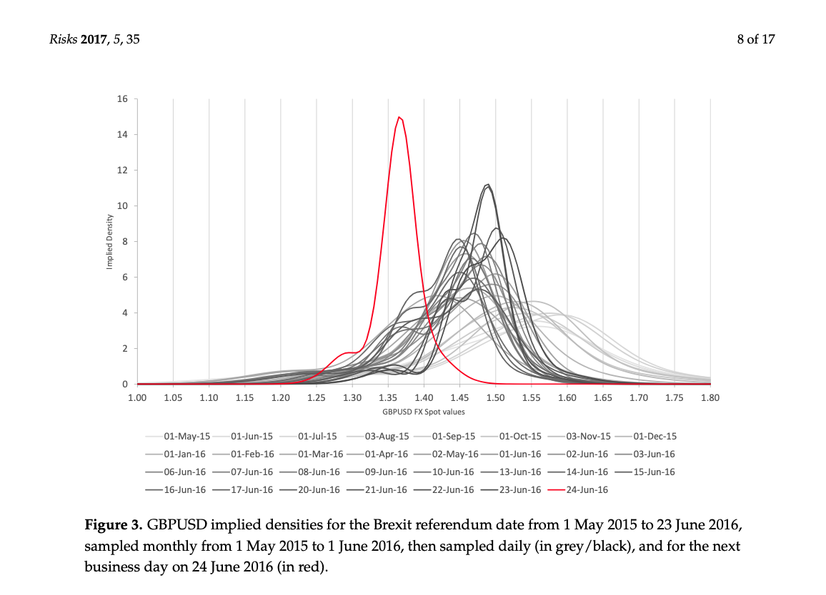
Implied distributions

Slide 5
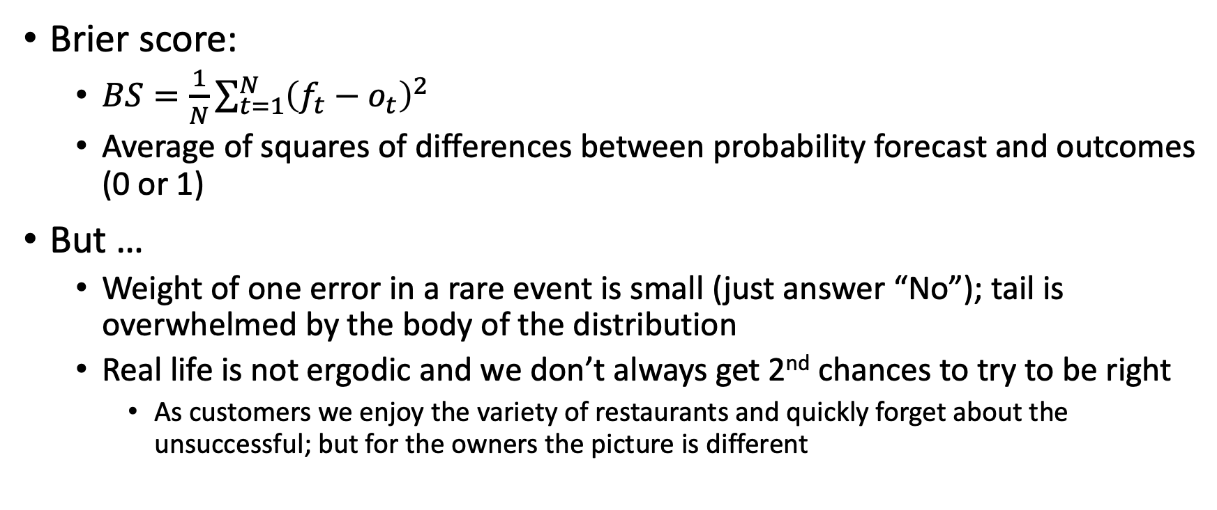
Reward function
Brier score:
$BS=\frac{1}{N}\sum_{t=1}^{N}{{\left(f_{t}−o_{t}\right)}^{2}}$
Average of squares of differences between probability forecast and outcomes (0 or 1)
But …
Weight of one error in a rare event is small (just answer “No”); tail is overwhelmed by the body of the distribution
Real life is not ergodic and we don’t always get 2nd chances to try to be right
As customers we enjoy the variety of restaurants and quickly forget about the unsuccessful; but for the owners the picture is different

Slide 6
Domain restriction
“… IARPA-style tournament, where event base rates cluster in the 10%–90% range.”
Either frequent time series (e.g. monthly) or discrete events (“Will President X be re-elected / deposed / …?”)

Slide 7
Domain restriction
But:
By definition the important questions have an unbalanced distribution once you frame it correctly: “Will the surprise be big enough to matter?” tends to be no for most of the time because it matters AND we acted on it in the past to make it so (e.g. “Will a commercial plane crash with deaths in the next week?” or “Will children in the backseat of cars die by the thousands next year?”)
The phrasing matters: “Will ___ be in power 2 years from now?” can be interpreted as “Will ___ be deposed”, “die by natural causes”, etc.
Payoffs are everywhere (back to the example of the Kansas City woman: why did she leave early? Arrival times are fat-tailed in the wrong way, and consequences are always negative)

Slide 8
Ergodicity in economics
Sequential decisions need to take into account paths to ruin
Decisions dependent on path and context
Debunking of “Marshmallow Experiment” – wealth confounder
Even if I can predict the future on average I cannot act according to this average prediction

Slide 9
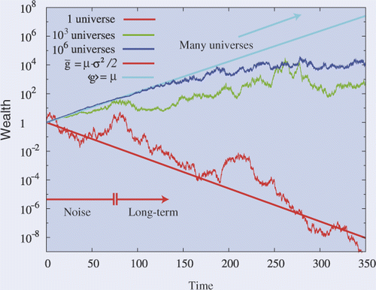
Ergodicity in economics – Ole Peters

Slide 10
Reinforcement learning
Landscape of positive and negative rewards
How rugged is the landscape?
If the consequences of failure are small and I can try again with my cumulative experience I can ”overfit”
Am I really learning about the processes involved? Or just overfitting?
Solving the maze from “The Mysterious Benedict Society” (the book):
Look for the patterns that point to the right way (Reynie)
Blind trial and memorizing the path (Sticky)
Bypassing the path (Kate)

Slide 11
Why forecasting has been successful?
Division of labor:
“divisions of labor: in this case, between analysts whose job is making accurate forecasts and policymakers whose job is making value judgments (setting thresholds for issuing alarms)”
Useful math/algo “washing” of responsibility (Different reactions during COVID show that there’s enough “research” around to justify any position)
Momentum feedback (better economic data leads to more confidence leads to more investment leads to …)
Survivorship bias: only work in time series that remain relevant

Slide 12
Why forecasting has been successful?
Excuses:
No one could have predicted …
This was a (large number) sigma event …
All of our data …
Back to division of labour (no personal liability):
Asset management
Large banks

Slide 13
Systems that matter are complex
Feedback cuts it both ways:
Recent past influences present and expectations of future
But knowledge of which model is used to manage the system changes behaviour (“An Engine, Not a Camera”)
“The only function of economic forecasting is to make astrology look respectable.” - Ezra Solomon

Slide 14
We have tools
Bayesian methods can deal with the evolution of probability distributions
Start with more general priors
Beware of managed processes (e.g. pegged currencies)
Is every new data point equally informative?
In a regime switching model it might only inform the switching probability, but not the dynamics of the other regime
Only way to get slope of tail is with increasing payoff

